Slide 1
Taxonomic diversity of benthic functional dendrograms
Anna Krystalli, Tom Webb

Slide 2
Functional Vs Taxonomic diversity
Growing need to effectively assess and monitor trends in biological community integrity and ecosystem function with few resources
2 general approaches:
Monitor taxonomic attributes of community
Diversity, Richness, Taxonomic distinctness
Monitor functional aspects of a community
Limited by data availability on traits, a particular problem in marine systems
Can be geared towards monitoring particular ecosystem functions

Slide 3
Objective
As trait data become more available and added to analyses does functional diversity start to approach taxonomic diversity
How does number of species and traits affect this relationship?

Slide 4
Data
Summer project: Jane Hosegood collated trait data on 575 North Sea benthic macroinvertebrate species in Webb et al. 2009 and for 973 UK benthic macroinvertebrate and demersal fish species in Tyler et al. 2012 from a variety of sources to submit to WoRMS
Data collated into single table limiting analyses to 123 with traits for >10 traits
TRAIT VARIABLES: "Age_at_Maturity” ,"Body_Size" ,"Developmental_Mechanism" ,"Diet" , "Fecundity”,"Feeding_Method”, "Habitat" , "Larval_Duration" , "Migration" "MovementMethod" , "Reproductive_Frequency" , "Reproductive_Period" "Reproductive_Timing" , "Sociability"

Slide 5
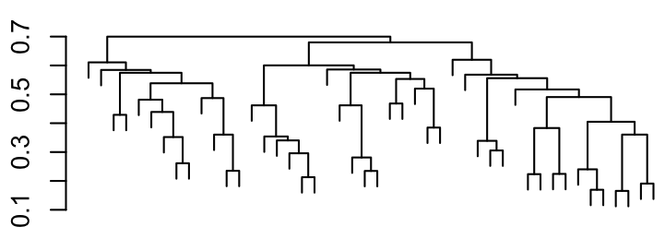
Analyses
3 analyses carried out following similar protocol
Produce functional diversity dendrogram
Used “gower” distance & asymmetric binary variables
Compile species identities at each branch
Calculate Taxonomic diversity of each cluster
Calculate correlation between cluster height & cluster D+
(average taxonomic path length)
Varied number of species and traits in analyses according to data availability (replicating realistic trade-offs in benthic biodiversity assessment?)
Held number of species constant and varied number of traits. (spp=46)
Held number of traits constant and varied number of species (var=7)
(to be consistent with analysis 1, number of spp was varied according to trait data availability

Slide 6
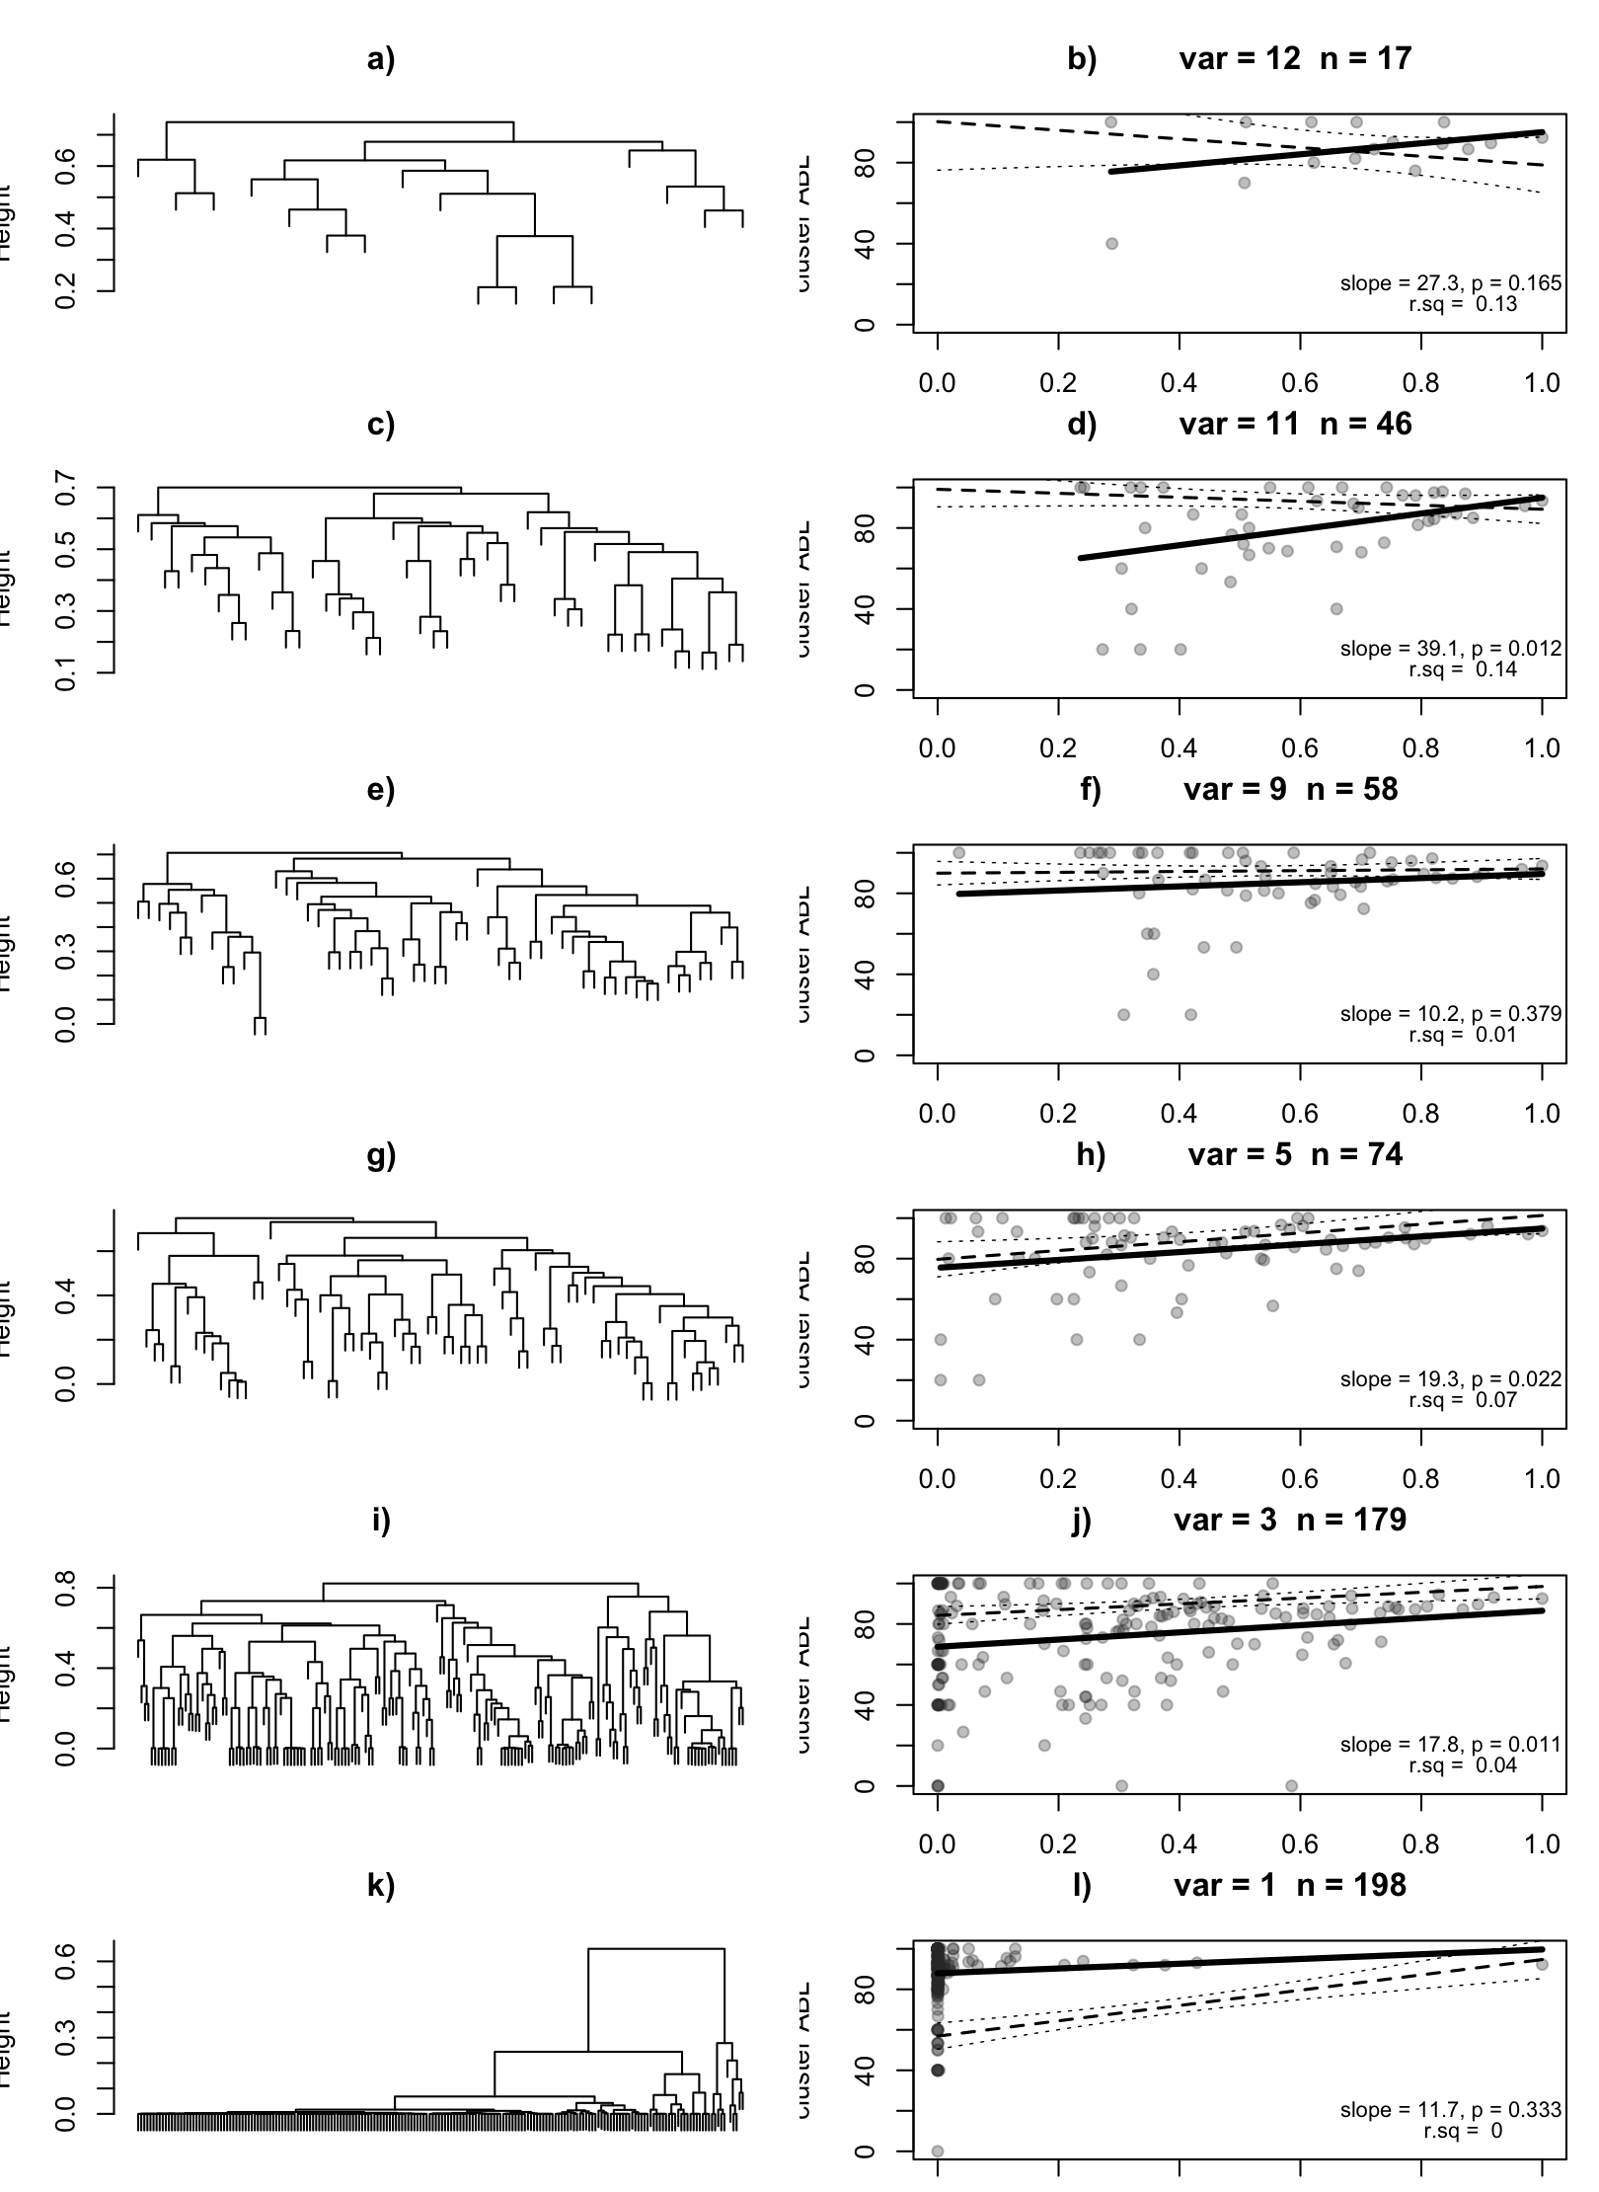
Results
SIMULTANEOUS VARIATION
Large proportion of clusters (70-80%) completely taxonomically distinct
Relationship appears generally positive but only significant in a couple of cases
Relationship appears to flatten as species increase and no. traits decreases
Changes to clustering appear stable apart from when only 2 variables where used.
Most interesting: The progressively flattening wedge shape of data distribution
Notes:
Firstly, plots still under construction
Second want to fit lines but wanted to ask some advice as the last panel seems like it might be best described by a higher order function (linear does not seem appropriate)
Has anyone ever used r to calculate taxonomic dissimilarity matrices? When taxo2dist won’t work I assumed it’s because they share no taxonomic similarity (species of completely different phyla) set to 100

Slide 7
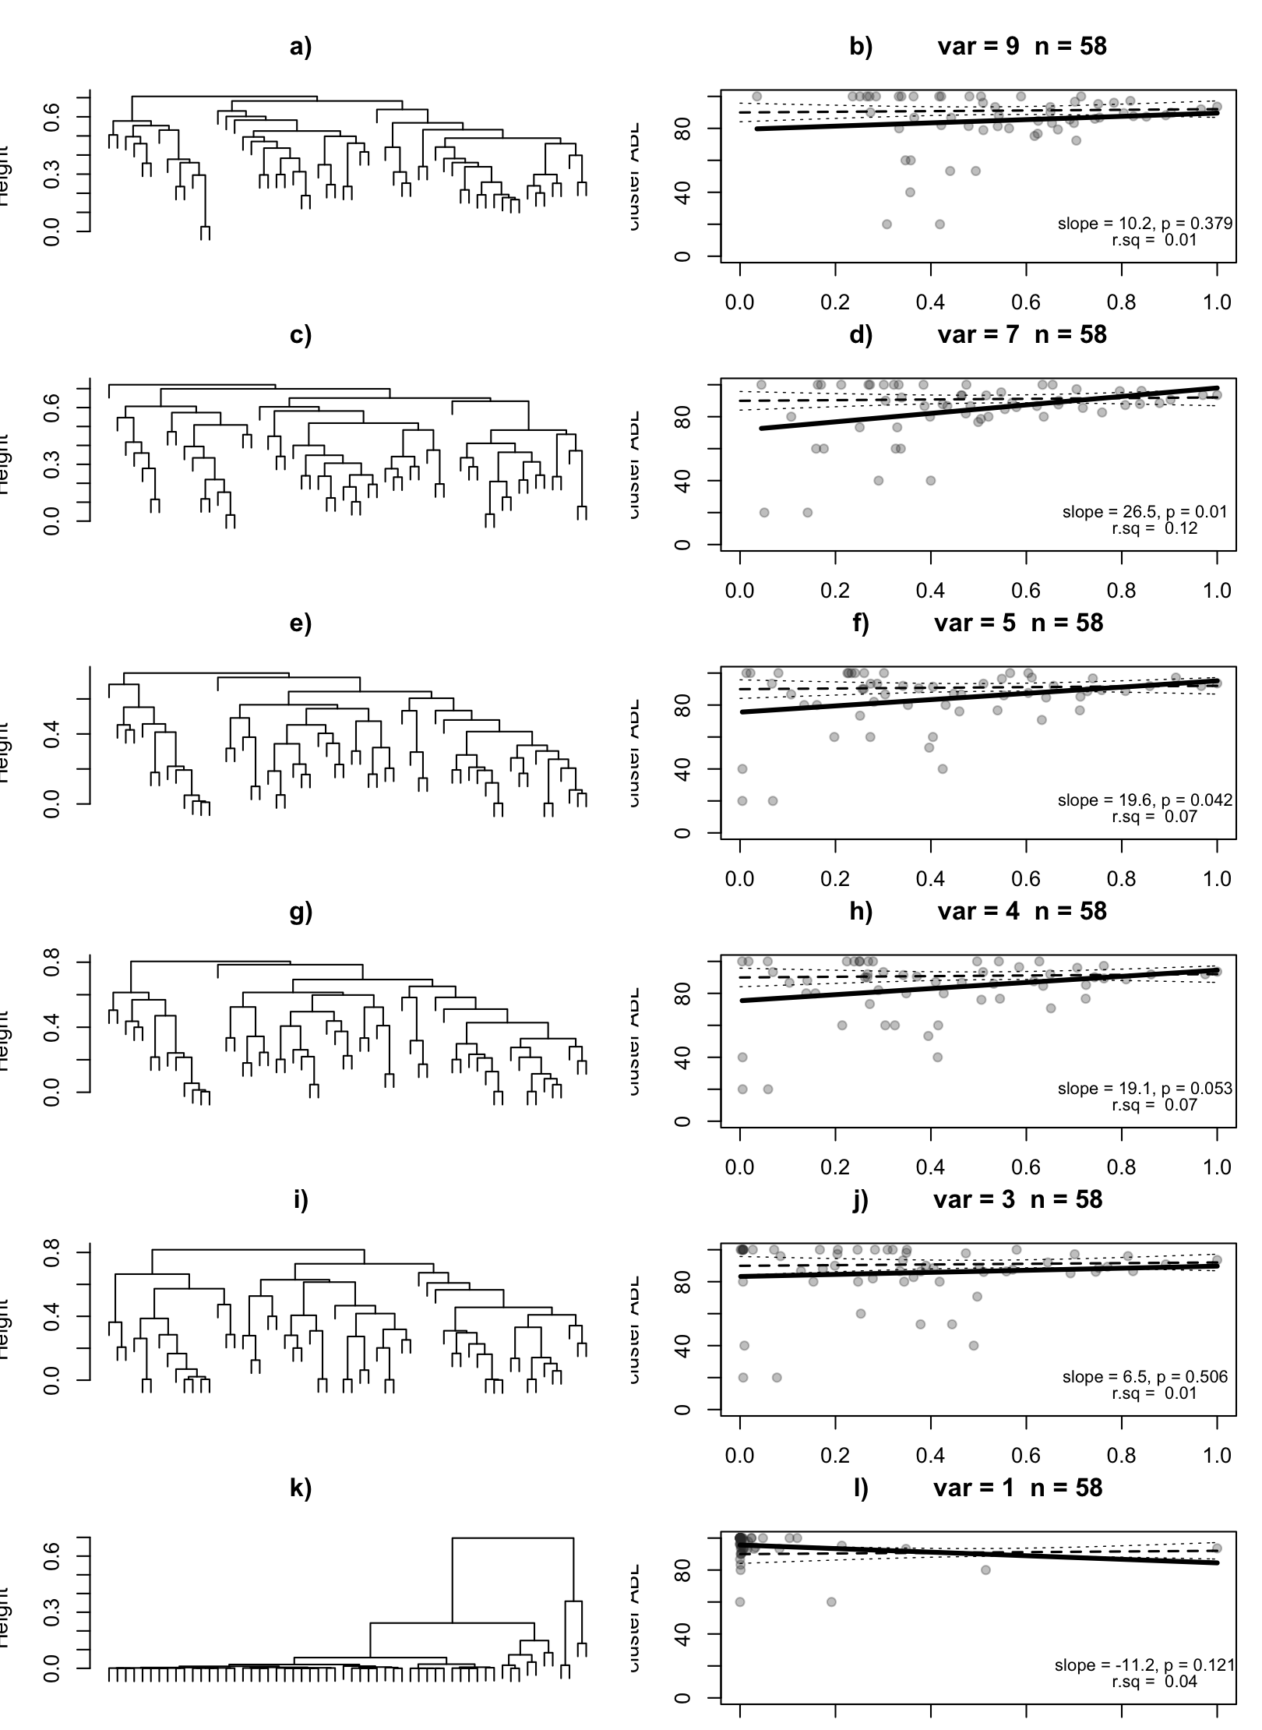
Results
VARIABLE VARIATION
Again, large proportion of clusters (70-80%) completely taxonomically distinct
Relationship again appears to progressively flatten as variables decrease
Again, Changes to clustering appear relatively stable apart from when only 2 variables where used.
Notes:
Firstly, plots still under construction
Second want to fit lines but wanted to ask some advice as the last panel seems like it might be best described by a higher order function (linear does not seem appropriate)
Has anyone ever used r to calculate taxonomic dissimilarity matrices? When taxo2dist won’t work I assumed it’s because they share no taxonomic similarity (species of completely different phyla) set to 100

Slide 8
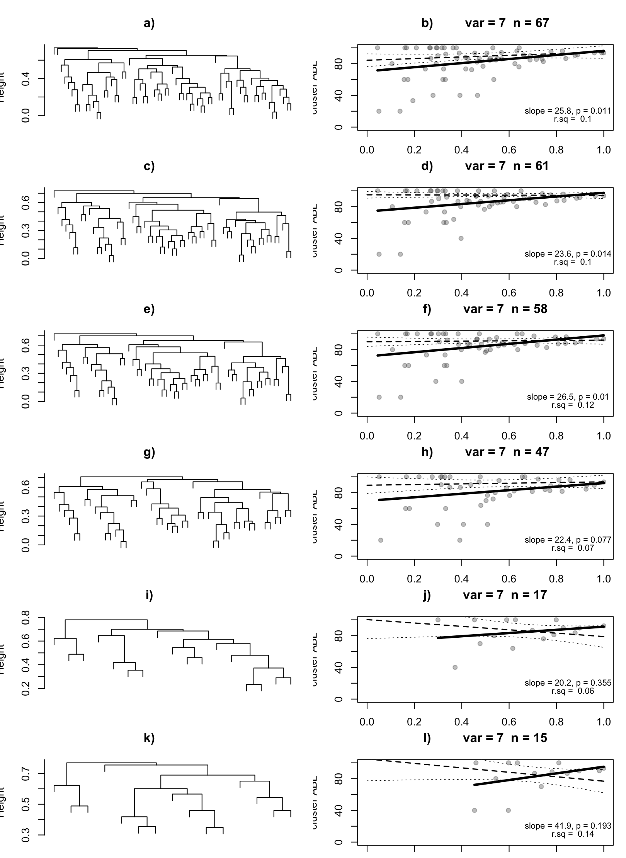
Results
SPECIES VARIATION
Again, large proportion of clusters (70-80%) completely taxonomically distinct
Apart form e) slopes remain unchanging and not generally significant
Changes to clustering appear relatively stable throughout. Few trait variables seem main driver of drastic clustering shift.
Notes:
Firstly, plots still under construction
Second want to fit lines but wanted to ask some advice as the last panel seems like it might be best described by a higher order function (linear does not seem appropriate)
Has anyone ever used r to calculate taxonomic dissimilarity matrices? When taxo2dist won’t work I assumed it’s because they share no taxonomic similarity (species of completely different phyla) set to 100

Slide 9
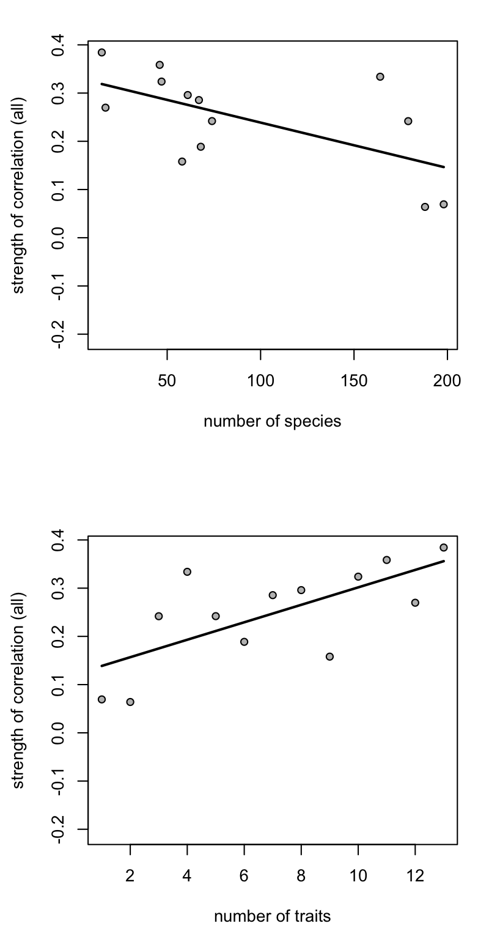
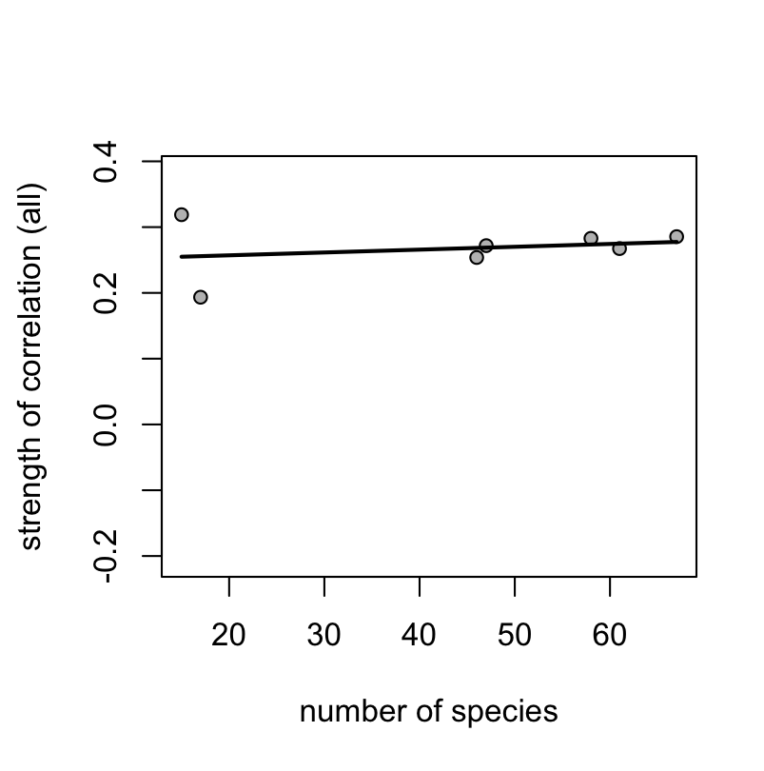

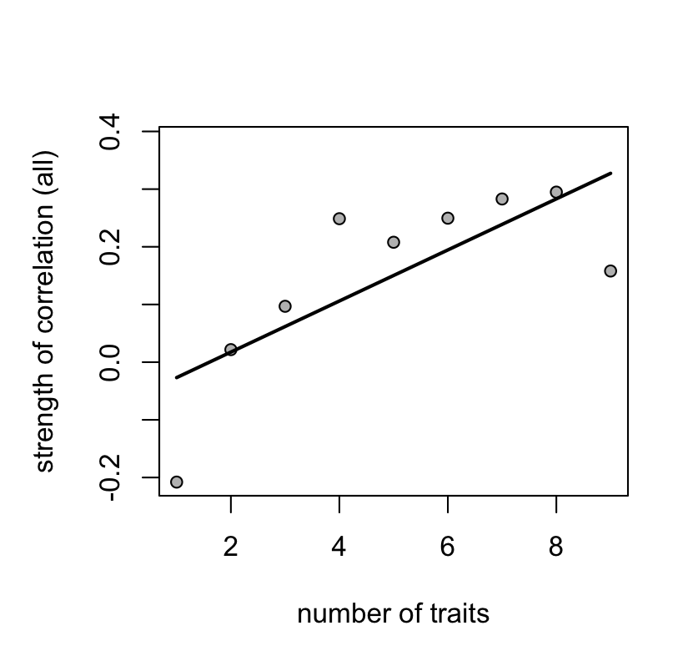


Branch height vs D+ relationship
1) BOTH
3) SPECIES
Variable variation appears the main driver in the relationship
2) VARIABLES

Slide 10
 | t₁ | t₂ | t₃ | t₄ | t₅ |  |  | t₁ | t₂ | t₃ | t₄ | t₅ |  |  | t₁ | t₂ | t₃ | t₄ | t₅
s₁ |  |  |  |  |  |  | s₁ |  |  |  |  |  |  | s₁ |  |  |  |  |  |  |  | s & t included in analysis
s₂ |  |  |  |  |  |  | s₂ |  |  |  |  |  |  | s₂ |  |  |  |  |  |  |  | s excluded
s₃ |  |  |  |  |  |  | s₃ |  |  |  |  |  |  | s₃ |  |  |  |  |  |  |  | t excluded
s₄ |  |  |  |  |  |  | s₄ |  |  |  |  |  |  | s₄ |  |  |  |  |  |  |  | data for s & t combination
s₅ |  |  |  |  |  |  | s₅ |  |  |  |  |  |  | s₅ |  |  |  |  |  |  |  | not available
s₆ |  |  |  |  |  |  | s₆ |  |  |  |  |  |  | s₆
s₇ |  |  |  |  |  |  | s₇ |  |  |  |  |  |  | s₇
s₈ |  |  |  |  |  |  | s₈ |  |  |  |  |  |  | s₈
s₉ |  |  |  |  |  |  | s₉ |  |  |  |  |  |  | s₉
A) Both
B) Traits
C) Species

Slide 11
RESERVATIONS
NULL model?
Need to compare to expectation of the average trend in D+ expected by simply going up a taxonomic tree?
Not sure the question is framed correctly / I am interpreting correctly?
Main assumption here: if taxonomy = FD then higher taxonomic groups branch off early on in functional space and continue to subdivide internally <- seems to me unrealistic
Trait inclusion
Sequence & criteria for inclusion could have large effect on result (some traits cause larger shifts in clustering than others <-at the minute sequence of inclusion dictated by
Trait weighting / modality definition?

Slide 12
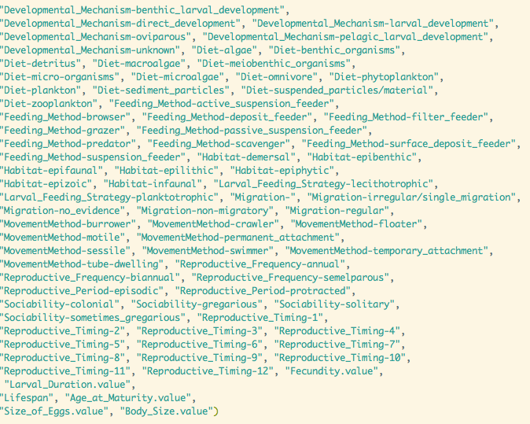
Trait modalities

Slide 13
CAVEATS
Hypothetical assemblage, These species are not necessarily found together on site
Community assembly in nature may well prove such an analyses unrealistic
BUT – would be interesting to perform such an analysis on real survey data.
Trait covariation –How would it affect analysis?

Slide 14
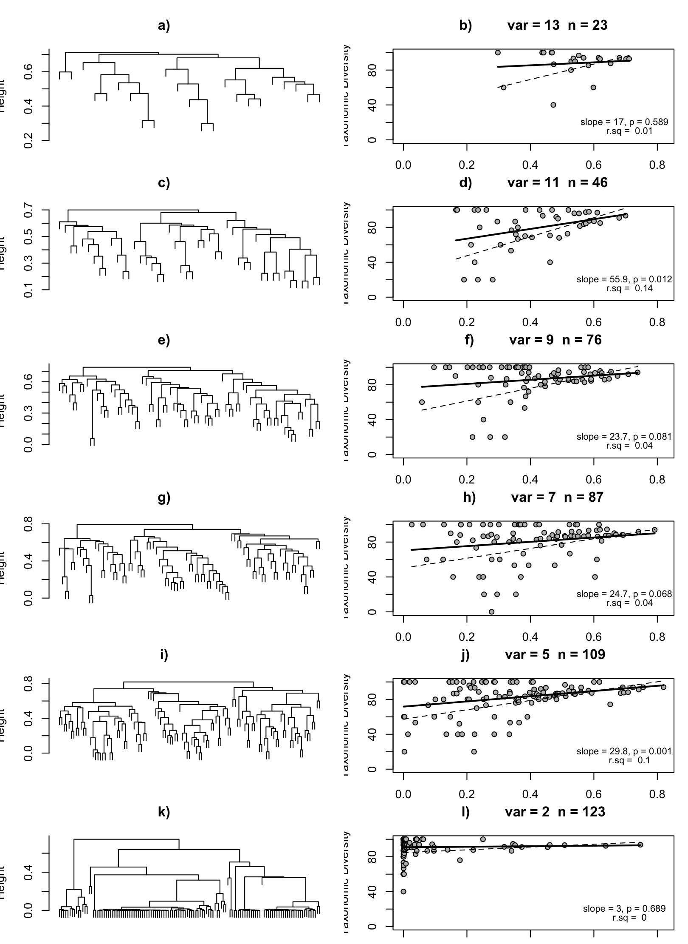
For me -> most interesting is the spread of the data
Can it tell us something about how taxonomically conserved some areas of functional space are?
Could the question evolve into:
How taxonomically distinct is functional diversity?
Solid clustering methods required!

Slide 15
Questions?

Slide 16
I mean…HELP!!

